Slide 1
A-10 Cx Dataset: ERSI Blind Predictions
Phase II
Robert Pilarczyk
Group Lead – Structural Integrity
Hill Engineering, LLC
rtpilarczyk@hill-engineering.com
Phone: 801-391-2682

Slide 2
New A-10 Cx Testing
Purpose
  The A-10 program is transitioning toward using residual stresses from cold expansion directly in damage tolerance analyses. A test program was developed to target and isolate the load history and residual stress effects for Cx holes. Fatigue tests include baseline non-Cx and Cx holes, constant amplitude and spectrum loading, and are complimented with residual stress measurements for each condition
Test Data
  Testing and fractography completed by SwRI and APES

Slide 3
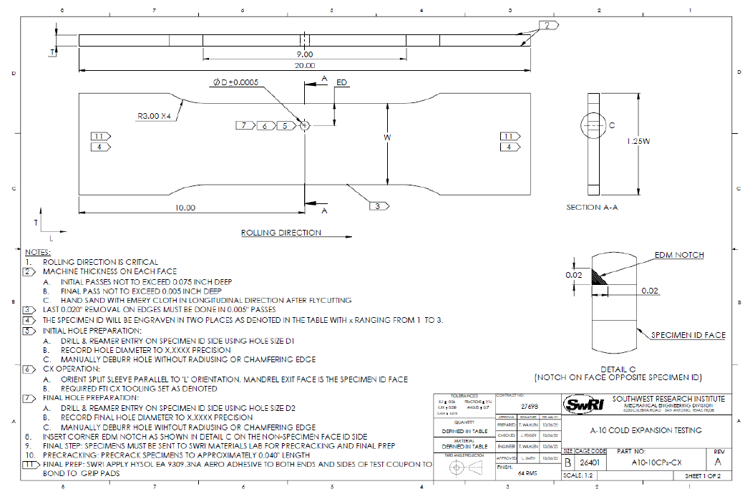
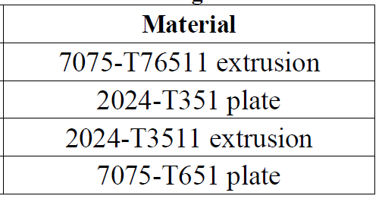
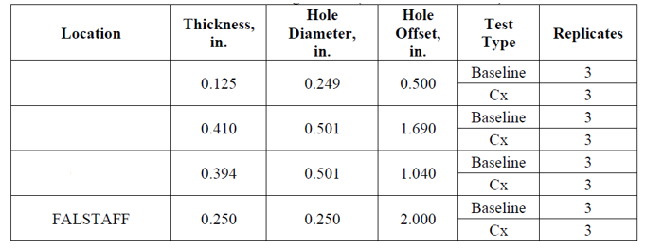
New A-10 Cx Testing, Constant Amplitude Tests
Input Data
  Geometry
    Various (see table)
  Material
    Various (see table)
  Starting flaw
    Notched, pre-cracked, and final reamed
  Cx conditions
    Baseline non-Cx and Cx holes
  Loading
    Constant amplitude w/ markerbands
    Max stresses = 23 and 25 ksi
    Stress ratio = 0.1, 0.15

Slide 4
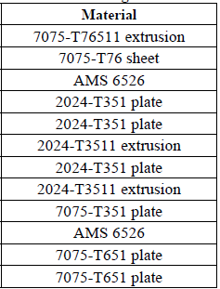
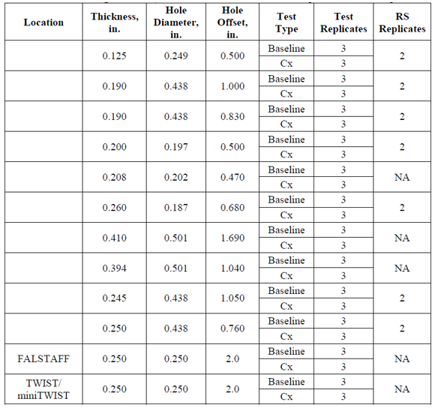
New A-10 Cx Testing, Variable Amplitude Tests
Input Data
  Geometry
    Various (see table)
  Material
    Various (see table)
  Starting flaw
    Notched, pre-cracked, and final reamed
  Cx conditions
    Baseline non-Cx and Cx holes
  Loading
    Variable amplitude

Slide 5
ERSI - A-10 Round Robin
Goals
  As a collective working group, complete blind predictions based on our best practices
  Compare/contrast predictions vs test results
  Utilize findings to refine analysis approach and best practices
Approach
  Down select dataset to define analysis conditions
  Establish initial data and analysis approach/approaches
  As a team, complete blind predictions

Slide 6
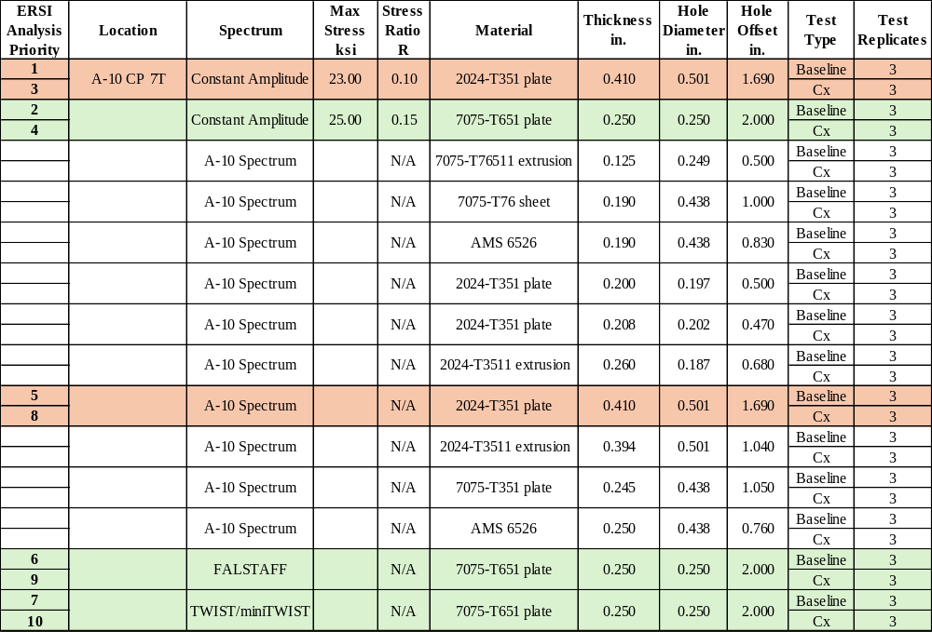
ERSI - A-10 Round Robin
Down-selection of Conditions
Phase II

Slide 7
ERSI - A-10 Round Robin
Conditions
  Materials
    2024-T351 and 7075-T651
  Spectrum
    Constant and variable amplitude
    A-10 wing spectrum, FALSTAFF, and miniTWIST
  Residual stress
    Baseline and Cx conditions
    Gathering applicable RS data
  Test replicates
    Typically (3) each condition
  Additional information
    Post-test fractography for each coupon

Slide 8
ERSI - A-10 Round Robin
Approach
  Phase I: Baseline non-cx conditions, CA loading
    Complete predictions & compare/contrast relative to test data
    Update any analysis inputs, as required
  Phase II: Cx conditions, CA loading
    Complete predictions & compare/contrast relative to test data
    Evaluate life and crack shape evolution
    Revisit residual stresses and implementation approach, as necessary
  Phase III: Baseline non-cx conditions, VA loading
    Complete predictions & compare/contrast relative to test data
    Review crack retardation and define approach for Cx conditions
  Phase IIII: Cx conditions, VA loading
    Complete predictions & compare/contrast relative to test data
  Document comparisons and associated lessons learned / best practices for all phases

Slide 9
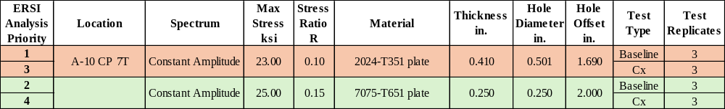
ERSI - A-10 Round Robin
Phase II
  Baseline cx conditions, CA loading
    Follow similar analysis approach & inputs as Cx conditions
    Complete predictions & compare/contrast relative to test data
    Update any analysis inputs, as required

Slide 10
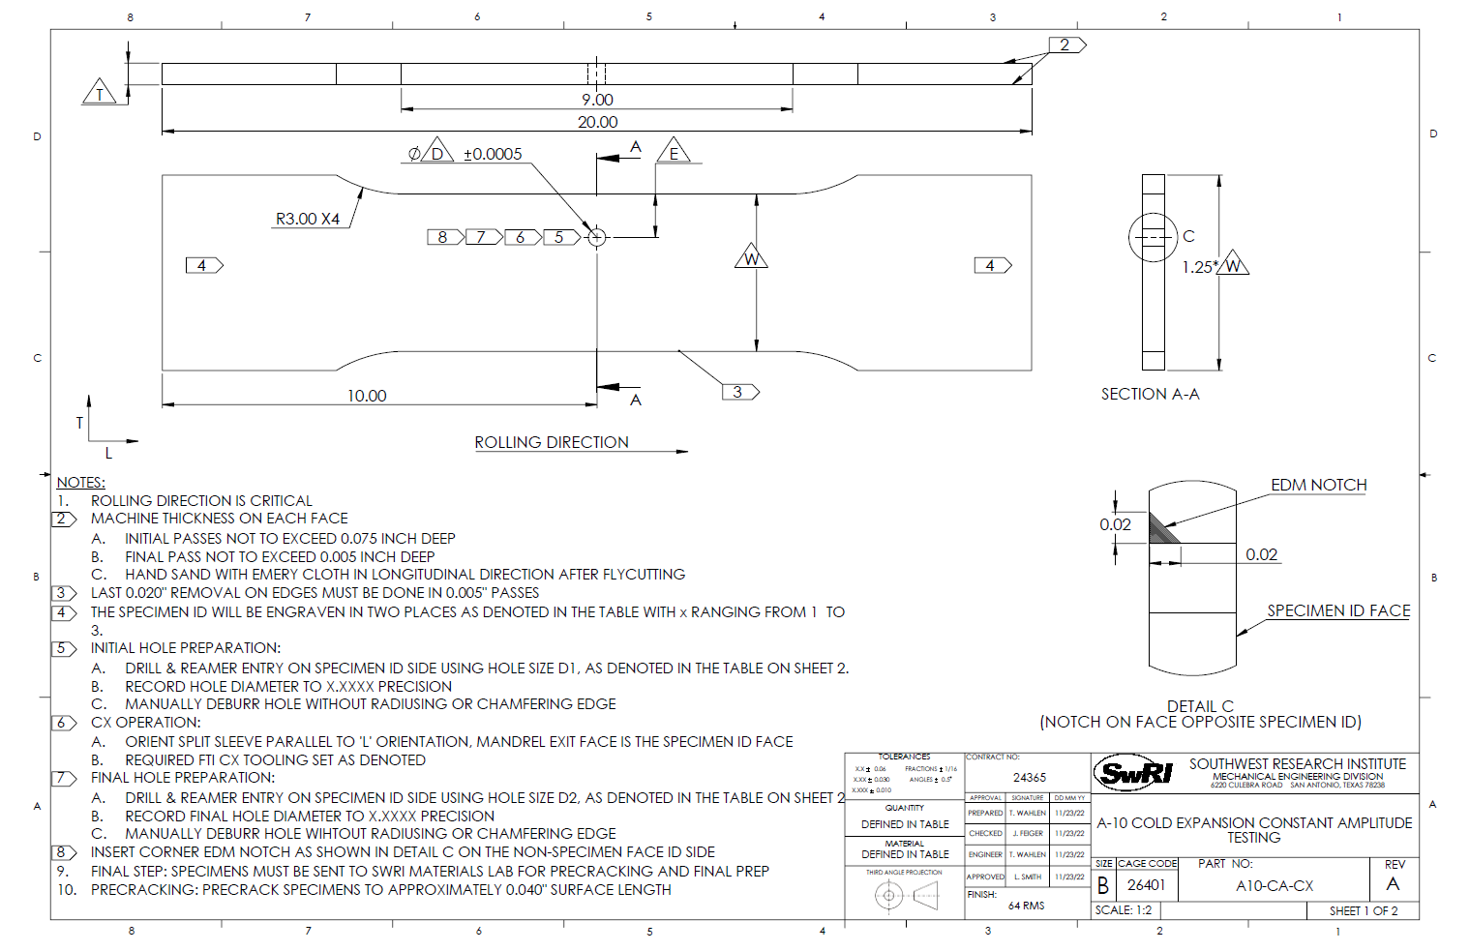
ERSI - A-10 Round Robin
Coupon Drawings

Slide 11
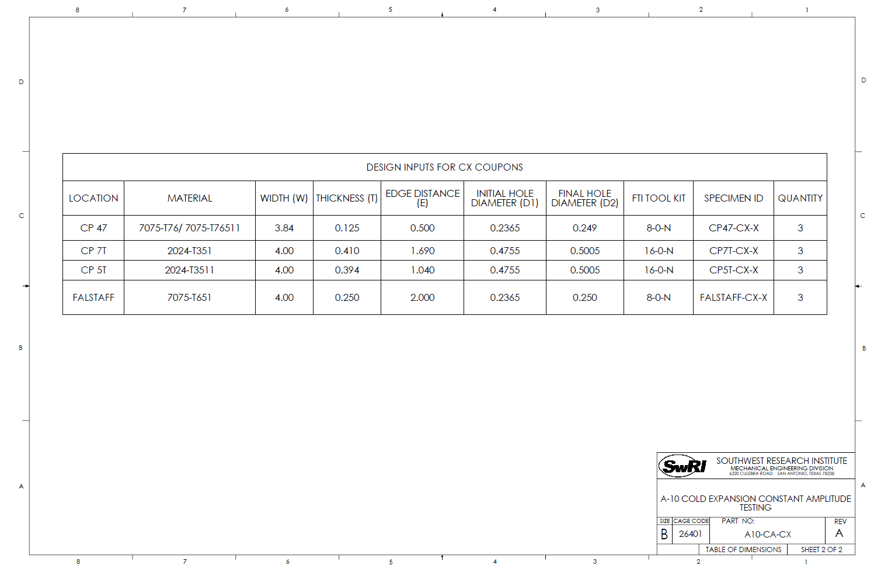
ERSI - A-10 Round Robin
Coupon Drawings

Slide 12
ERSI - A-10 Round Robin
Priority #3 (Cx condition, CA loading)
  Coupons CP7T-CX-06 through -08
  Geometry
    Thickness: 0.410”
    Width (test section): 4.00”
    Width (grips): 5.00”
    Hole Diameter: 0.501”
    Hole Offset: 1.690”
    EDM notch and crack on short ligament side
  Material: 2024-T351plate
    Source: Kevin Walker’s recently updated tabular lookup

Slide 13
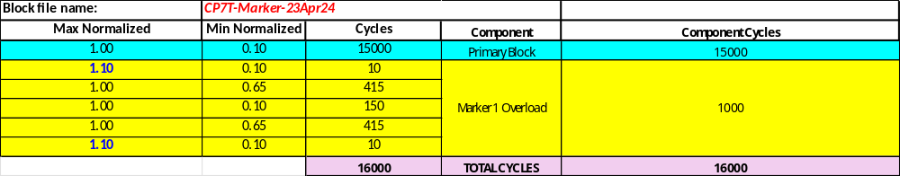
ERSI - A-10 Round Robin
Priority #3 (Cx condition, CA loading)
  Loading: CA, R=0.1, max normalized stress: 23 ksi
    Stress represents gross cross-section (no hole) of the gauge section
  Starting crack sizes:
y
Coupon CP7T-CX-07
Coupon CP7T-CX-08
X = surface
Y = bore
x
Crack Front Points
Surface = 0.06494”
Crack Front Points
Surface = 0.05238”
We don’t have markerband data. Do we want to still include these cases?
Assume a/c = 1.2?

Slide 14
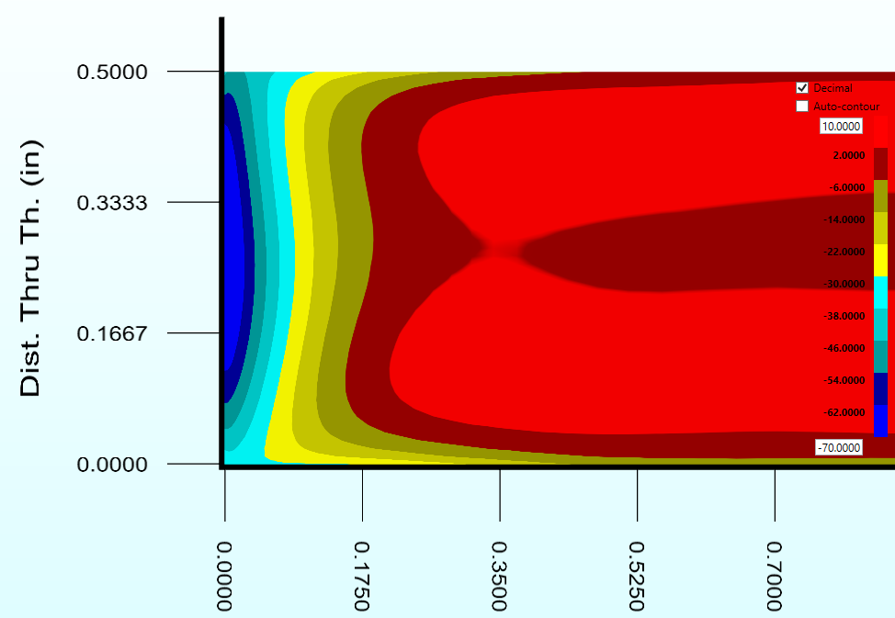
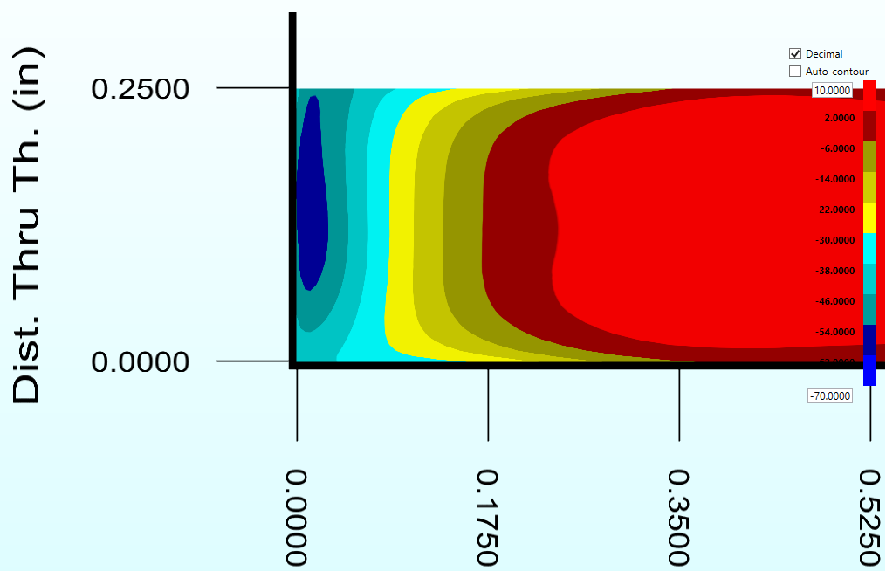
ERSI - A-10 Round Robin
Priority #3 (Cx condition, CA loading)
  Residual stress
    Data available from varying thickness study (1/8” – 1” thicknesses)
    All other geometry the same
      Dia: 0.500”
      Edge Distance: 2.0”
      Material: 2024-T351
      Applied expansion: 3.6-3.8%

Slide 15
ERSI - A-10 Round Robin
Priority #4 (Cx condition, CA loading)
  Coupons FALSTAFF-CX-07 through -09
    Note: coupon IDs are for consistency with later FALSTAFF spectrum tests, however, these tests are subject to constant amplitude loading
  Geometry
    Thickness: 0.250”
    Width (test section): 4.00”
    Width (grips): 5.00”
    Hole Diameter: 0.250”
    Hole Offset: 2.000”
  Material: 7075-T651plate
    Source: Jake Warner’s IFF Round Robin

Slide 16
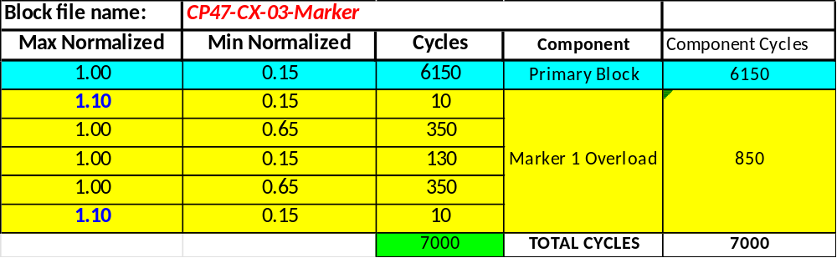
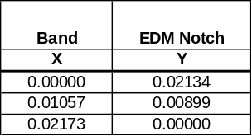
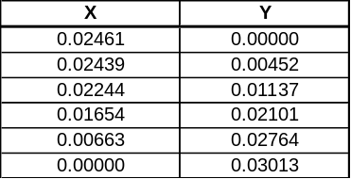
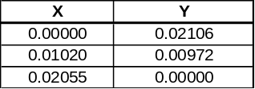
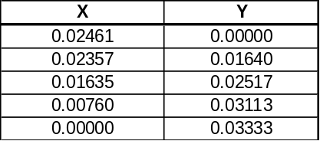
ERSI - A-10 Round Robin
Priority #4 (Cx condition, CA loading)
  Loading: CA, R=0.15, max normalized stress: 25 ksi
    Stress represents gross cross-section (no hole) of the gauge section
  Starting crack sizes:
FALSTAFF-CX-07
FALSTAFF-CX-09
EDM Notch
Crack Front Points
EDM Notch
Crack Front Points
X = surface
Y = bore

Slide 17
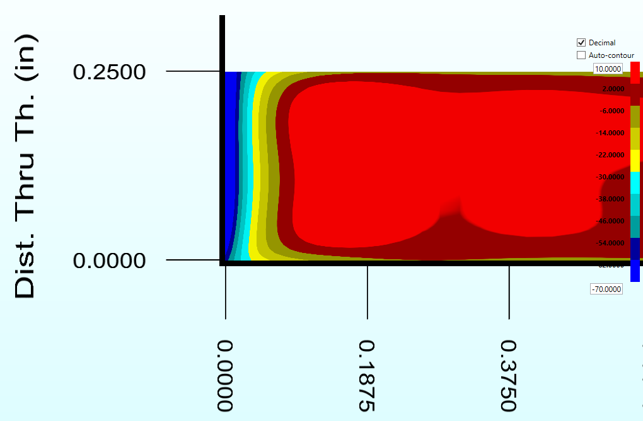
ERSI - A-10 Round Robin
Priority #4 (Cx condition, CA loading)
  Residual stress
    Data available from early A-10 testing (D1-X coupons)
      Same geometry, except low Cx (0.238” dia, 3.36%)
      Tested coupons were ~ mid Cx (0.2365” dia, 4.02%)
      FTI range is 0.235-0.238” dia, 3.36-4.68%
    All other geometry the same
      Diameter: 0.250”
      Thickness: 0.250”
      Edge Distance: 2.0”
      Material: 7075-T651

